Slide 1
Classroom Environment
Briana C. Croal
Liberty University

Slide 2

Introduction
Classroom environment entails social, emotional and physical aspects of the classroom.
Classroom environment incorporate the idea that teachers plays a great role in influencing student’s behavior and growth.
The instructor should always organize the classroom properly to attain positive learning environment.
Teachers should provide adequate guidance to the students rather than eliminating them from classroom activities.
According to Garett (2015), classroom management can be classified into five categories: discipline and behavioral management, classroom layout, rules, the significance of relationships, and instructions.
There are several classrooms approaches a teacher can use to promote effective learning. Some of them include: following class schedules strictly, consistency, encouraging active participation, and setting clear goals and expectations.

Slide 3
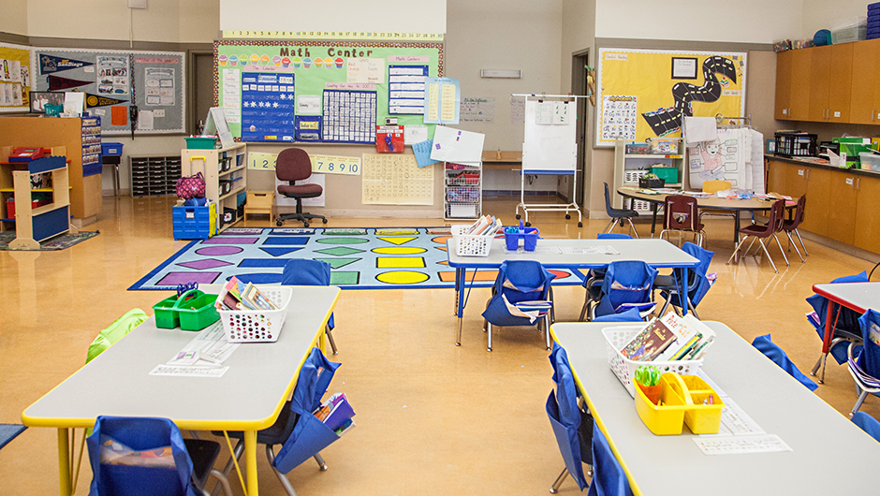
Set Up
The first element while developing a classroom management plan should be the physical design of the class.
Arrangement of furniture, setting up work centers, and storing materials and supplies are crucial tasks in the physical design of a classroom (Garrett, 2014).
To provide students with appropriate space for learning, educators should develop purposeful and thoughtful decisions on arranging learner’s desks, furniture, and other materials.
The arrangement of students' desks is not the only component of classroom physical layout.
Teachers must develop a plan to place their desks and other materials like computers regularly used materials like science experiments (Garrett, 2014).
However, the most appropriate classroom layout depends on size, teacher's goals, the shape of the classroom, and physical constraints.
Students usually require enough space for their desks and putting their personal belongings.
According to Capizzi (2009), classrooms should be arranged effectively for easier movement.
High-traffic areas and walkways should be open and clear.
While making class arrangements, teachers should consider materials required in-class sessions, space utilization, level, and age of students.

Slide 4
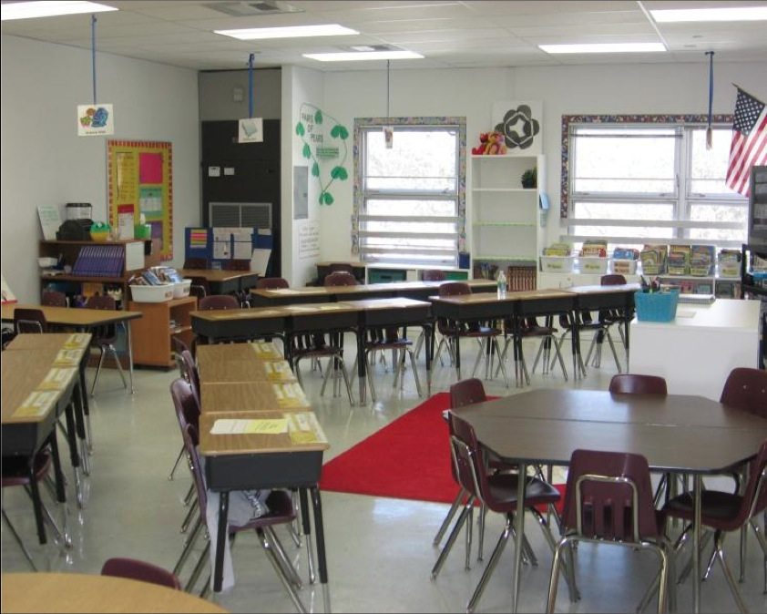
Student’s Arrangement and Position
Physical configuration of classrooms is quite crucial.
In-person classroom sitting arrangement impacts student’s motivation, learning, participation, and teacher-student relationship.
The teacher should adjust the class physical set up to maximize learners’ engagement.
This set up has a great impact on the communication patterns between the teacher and learners.
The physical arrangement of the classroom also influences the teacher’s choice of learning activities and pedagogy.

Slide 5
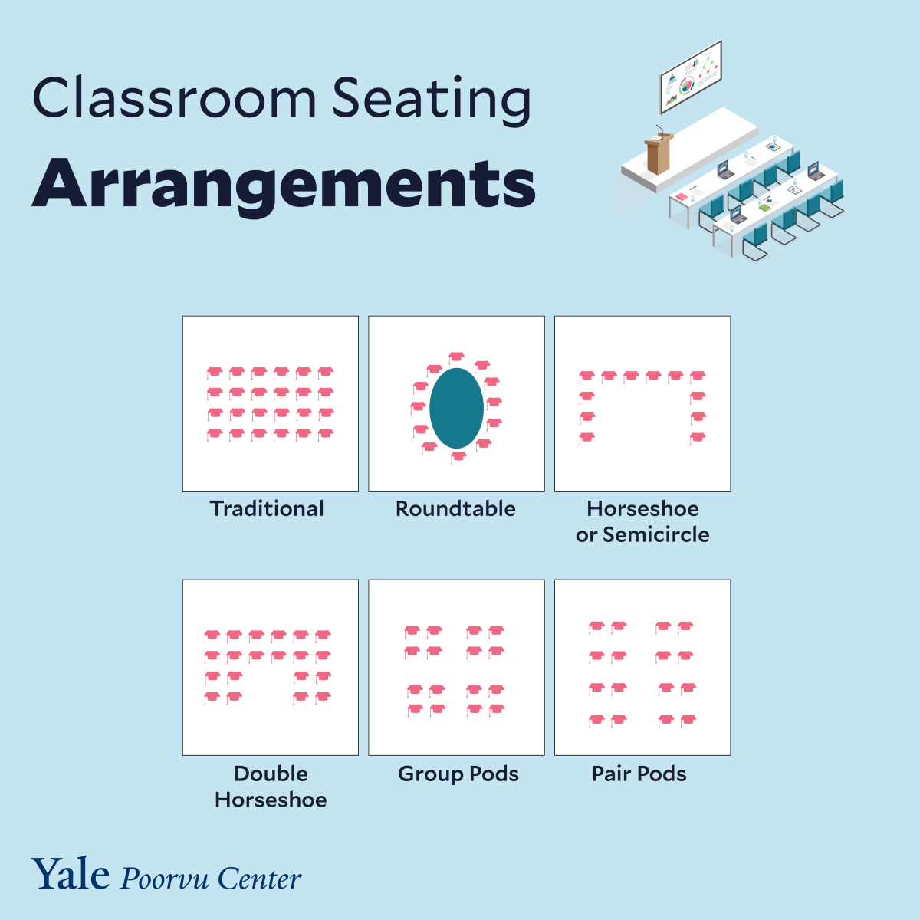
Student’s Arrangement and Position
Some of the common types of classroom sitting arrangement include traditional method, roundtable and pair pods.
In traditional arrangement, students are positioned in rows of fixed seating.
In traditional method, students sit while facing the instructor.
Roundtable arrangement is where students and the instructor sits around a particular table.
In pod or group pairs, the arrangement assumes rectangular or circular design and students have individual desks.
Learners can also be positioned in a U-shape design where they sit in a roundtable setup.

Slide 6
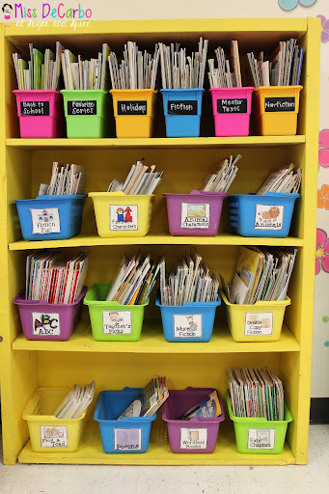
Placement of Resources in a classroom
Teachers should ensure that resources are arranged appropriately when in use and after the lesson.
It is crucial to establish a work zone where you place necessary resources for learning.
These resources should also be labeled to avoid confusion.
Books can be sorted by topics, genre and themes.
Book should also be placed on shelves either in front or at the back of the classroom.

Slide 7
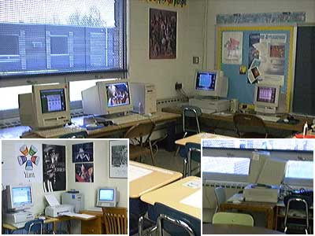

Placement of Resources in a classroom
Teachers can also put these books in books bins.
Computers should also be placed in isolated space where they are not likely to cause distractions.
The teacher’s desk should be placed at the front of the classroom since it gives him or her the best view of all students.

Slide 8

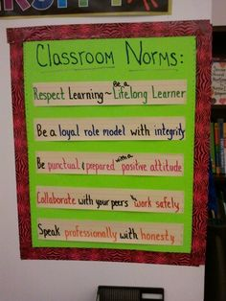
Rules and Norms
Classroom rules should be easier for students to understand and for educators to monitor.
Class rules help to communicate teacher’s expectations and promote mutual respect between students and teachers in the development of a positive learning environment.
As part of the classroom management plan, teachers should set between three to five rules by including the desired behaviors.
The rules need to be positively stated by explaining what learners should follow (Capizzi, 2009).
Teachers need to teach students about the rules using relevant examples about their application to class activities.
According to Hill (2014), classroom rules should be specific, simple, measurable, and clear.
According to Hill (2014), most Christian schools biblical approach in classroom management is crucial in supporting the biblical worldview, and thus their rules are based on biblical teachings.
Among the Jewish, class norms and rules are developed from traditions and are based on the blessing to allow everybody to join the unison (Kohn, 1999).

Slide 9
Conclusion
Classroom arrangement is a crucial aspect of classroom management.
Teachers should consider variables such as setup, student’s arrangement, placement of resources and rules and norms.
The arrangement of the classroom also depends on factors such as population and the nature of resources, among others.
Teachers should ensure that they create a positive environment to enhance learning.

Slide 10
References
Capizzi, A. M. (2009). Start the year off right: Designing and evaluating a supportive case. Pearson. Classroom management plan. Focus on exceptional children, 42(3).
Garrett, T. (2014). Effective classroom management: The essentials. Teachers College Press.
Garrett, T. F. (2015). Misconceptions and goals of classroom management. The Education
Hill, C. E. (2014). Elementary Christian school teachers are utilizing biblical concepts in Instruction, and curriculum development. Greenwood Publishing Group.
Kohn, D. B. (1999). Practical pedagogy for the Jewish classroom: Classroom management, instruction, and curriculum development. Greenwood Publishing Group.

